Slide 1

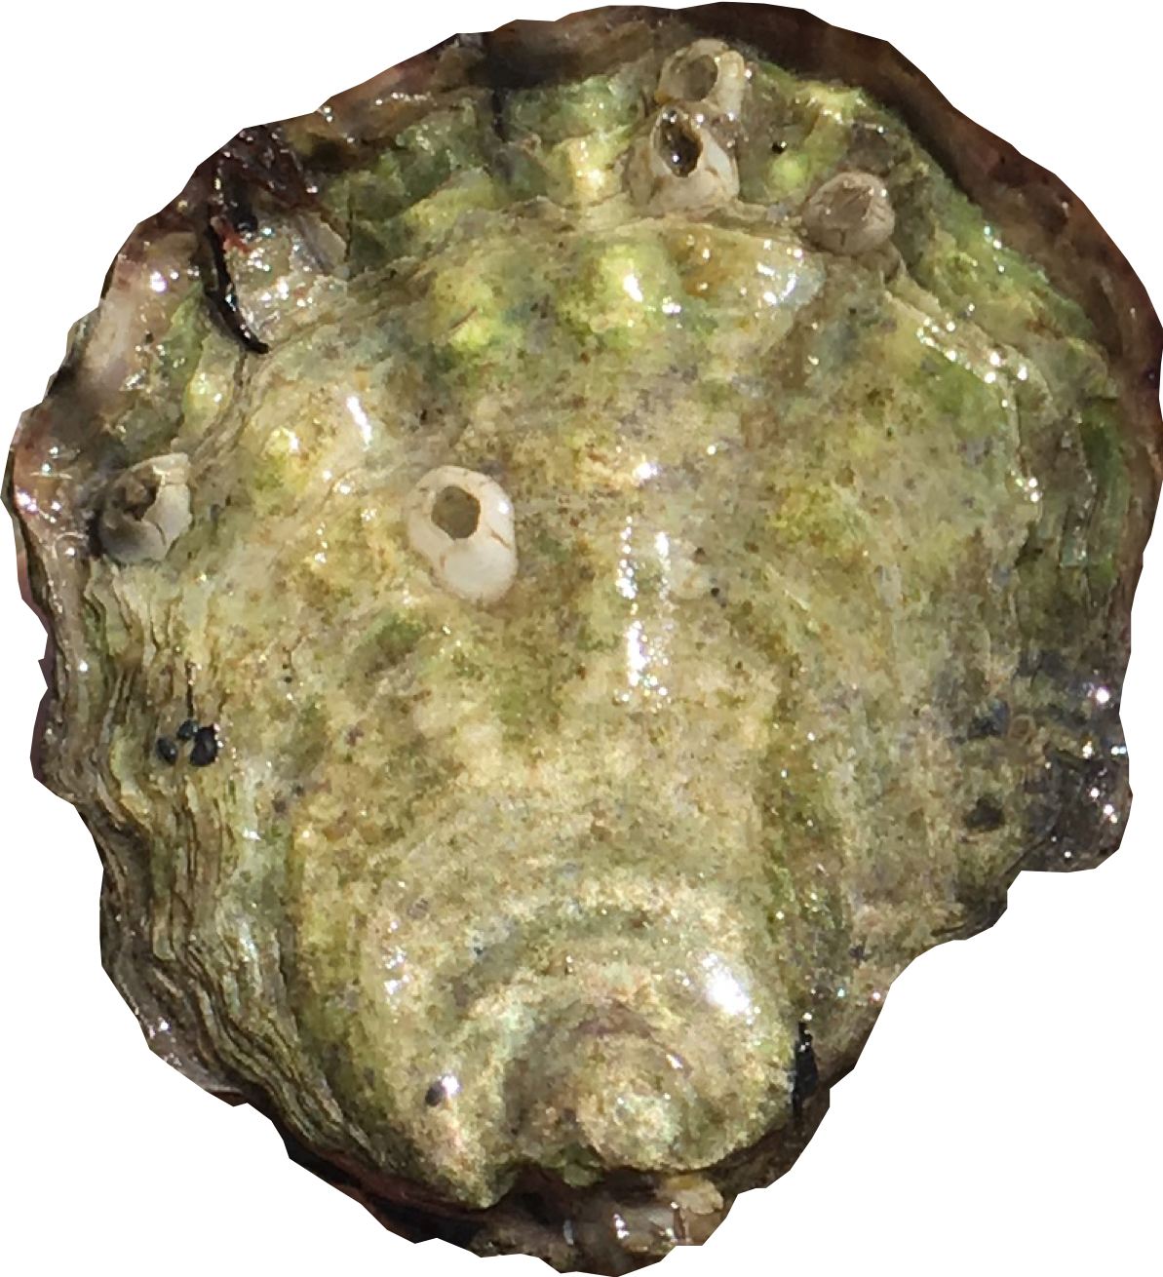
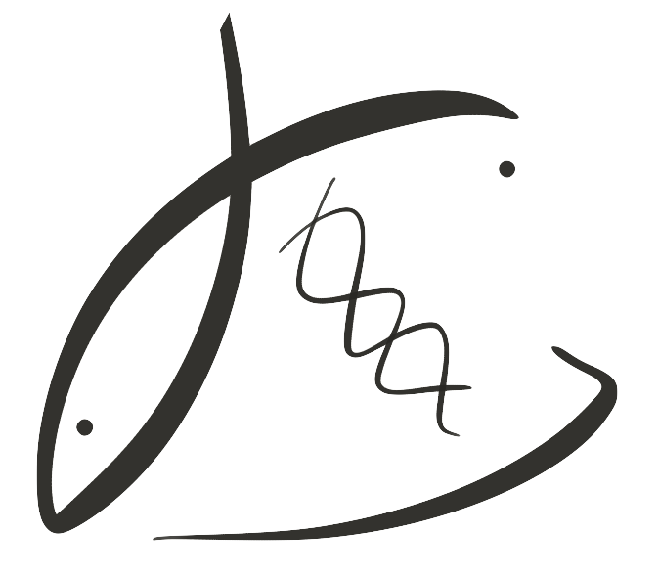




Oysters exposed to winter acidification produced larger larvae in spring, with higher survival 1 year later
Take a picture to download the full paper
Title: Subtitle
Leeroy Jenkins, author2, author3, author4
Carryover effects of temperature and pCO₂ across multiple Olympia oyster populations
Olympia oyster, Ostrea lurida
Native to N. American Pacific Coast
Females brood larvae for ~2 weeks
Hermaphroditic
Overexploited; now being restored
Grown and sold commercially
Small but mighty tasty
~35 mm
Laura H Spencer, Yaamini R Venkataraman, Ryan Crim, Stuart Ryan, Micah J Horwith, Steven B Roberts
Parents in treatment
Parents, offspring in common conditions
Offspring in field trial
Temperature
60 days, winter
pCO₂
52 days,
winter
Adults volitionally spawn
90 days, spring
Survival tested in 4 locations
90 days, summer
↑ winter temperature + ↑ pCO₂ =
larger larvae in spring
841 µatm
pH ~7.8
↑ parental pCO₂ = ↑ offspring survival, dependent on location
841 µatm
pH ~7.8
✳︎✳︎
1. Fidalgo Bay
2. Port Gamble Bay
a
b
a
b
6°C
✳︎✳︎
✳︎✳︎
b
Offspring reared (6°C only) common conditions, 1 year
100-
75-
50-
25-
0-
a
b
3045 µatm
pH ~7.3
a
a
3045 µatm
pH ~7.3
4 genetically distinct groups
hatchery reared to adulthood
✳︎✳︎
a
✳︎✳︎
Percent Survival
✳︎✳︎
↑ winter temperature = earlier larval release
N
↑
Larval shell width (µm)
a
3. Skokomish Delta
4. Case Inlet
a
a
a
a
841 µatm
pH ~7.8
a
100-
75-
50-
25-
0-
a
a
✳︎✳︎
b
10°C
✳︎✳︎
3045 µatm
pH ~7.3
b
Percent Survival
✳︎✳︎
Parental winter treatment
No. days to peak larval release
First observations of intergenerational carryover effects in an Ostrea species.
Parental exposure to stress may ”prime” offspring for stressful environment – a possible adaptation mechanism.
Olympia oysters
Could reproduce earlier after warmer winters, e.g. during marine heat wave
Winter acidification + warming may positively affect offspring – larger larvae (faster growth?), higher surviving juveniles.
Potential applications – Don’t buffer seawater or protect wild populations from acidification, adult exposure may be important
My Digital
Lab Notebook
Roberts Lab Website

